Slide 1




Pilot Freight Service Direct Lanes Project
New Direct Lanes Analysis
Team - Zhengkun Xu, Yueheng Wang, Xiang Yang, Yijie Wang, Benjamin Wang

Slide 2
Contents
1
2
3
4
5
Business Objective
Route Selection
Data
Model
Recommendation

Slide 3


Business Objective
Pilot’s current line haul operation may be inefficient.
Pilot
The Pilot Ground Network:
Greater transit time
Strict departure date
More handling and touches
Third-party Carriers
Higher cost
High dependency on third-party companies
Objective: Find direct lanes that could reduce transportation cost and optimize use of capacity.

Slide 4

Success Criteria
What does it mean to succeed?
Costs lower when applying direct lanes
Less touch/handling over transit period
Shorter transit time
Reduced the number of routes outsourced to other shipping companies

Slide 5
1
2
3
4
5
Business Objective
Route Selection
Data
Model
Recommendation

Slide 6

Data Source
We obtained the data from Pilot Freights Service’s snowflake database.
The tables used are as following:
AIRTRAKDB_CODES
AIRTRAKDB_ORHSTH
AIRTRAKDB_ORHSTP
TRAKLIBDB_CARRIER

Slide 7
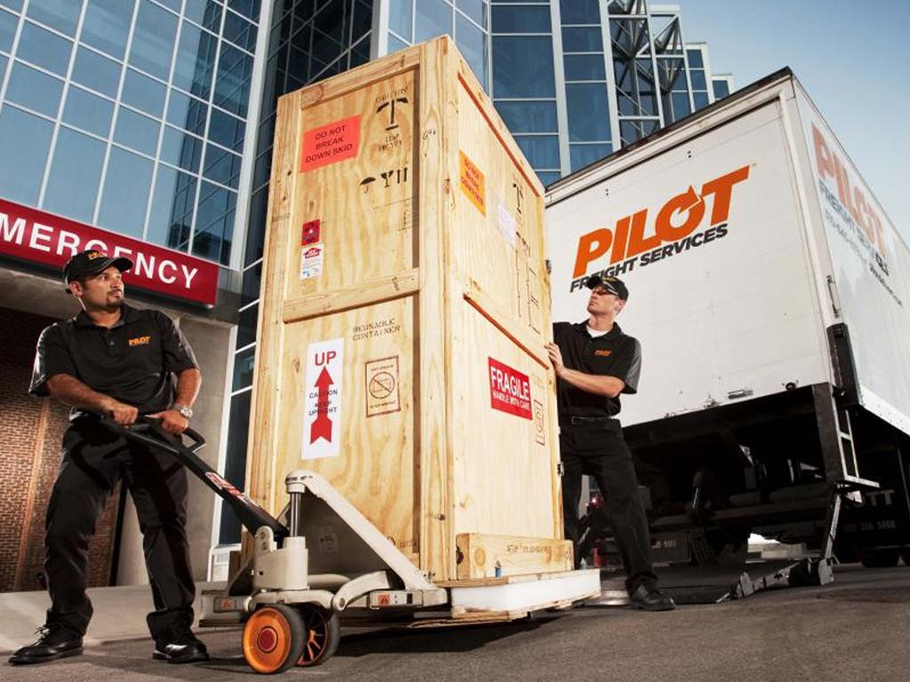
Required Data
The data required for our analysis is as following:
Cost
Capacity
Delivery Time
Number of Customer Orders
Distance

Slide 8

Data Cleansing & Preparation
Original dataset has above 0.1 billion entries.
Applied SQL to extract necessary columns. (ORD#01, TDAY25, etc)
The most recent data. (2018, 2019, 2020)
Each year has approximately 2 million observations.
Increasing credibility and enhancing accuracy.
Deleting all NA, empty, and duplicate entries.
The Cleaned Dataset (PFS_Combined.csv) has 4.8 million entries

Slide 9
1
2
3
4
5
Business Objective
Route Selection
Data
Model
Recommendation

Slide 10

Model Constructions
Degree Analysis
Analyze the routes with highest total chargeable weights from 2018 to 2020
Construct Direct lanes
Calculate the transit time of identified direct lines through Google Map
Schedule Analysis
Find out the optimal schedule for the new lines to optimize profit/transit time
Testing and Cost Analysis
Apply Python to construct a model to test whether the new route is feasible, and calculate cost and space savings

Slide 11
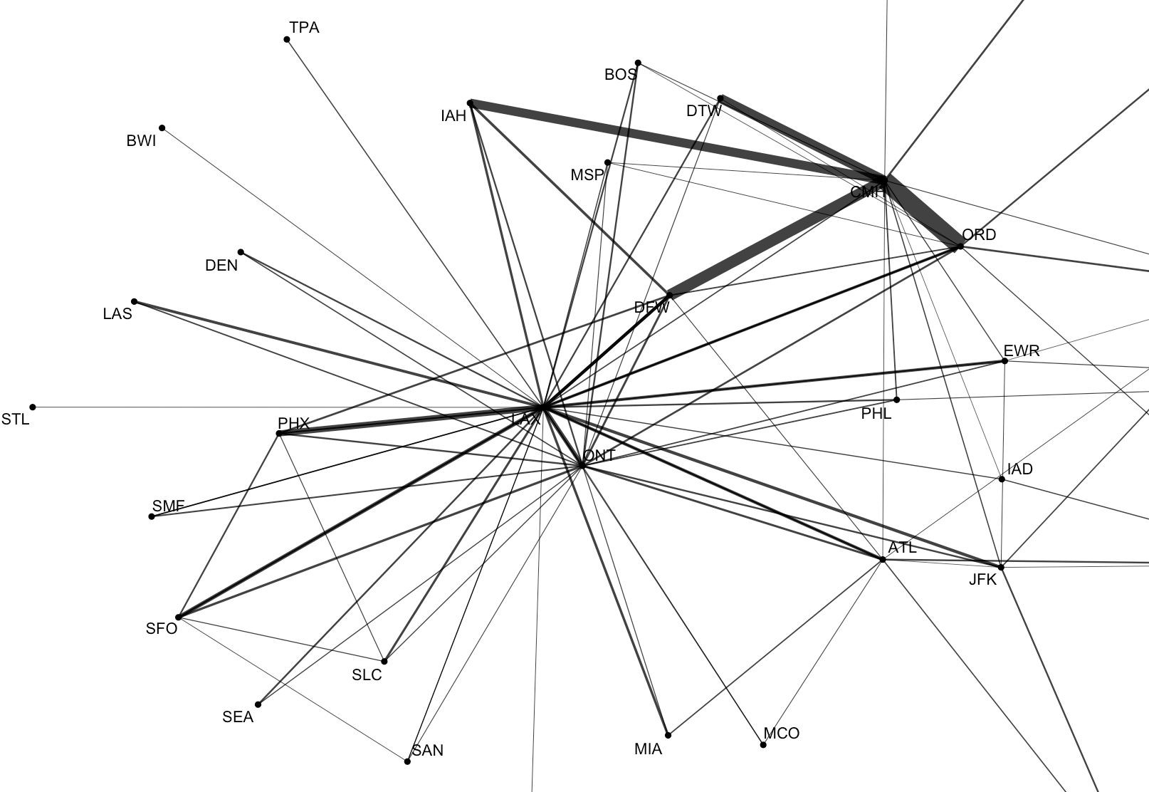
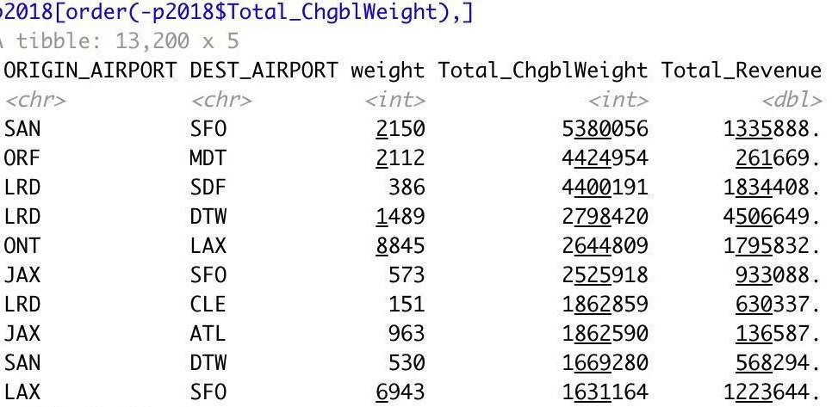
Degree Analysis
Conduct degree analysis based on total chargeable weights rankings
Excluded routes which shipper and consignee shared the same locations (e.g. LAX to LAX)
Excluded routes which origin or destination airport are CMH (Columbus, OH)

Slide 12

Possible Direct lanes
Based on Degree Analysis, we found 12 routes that have constant high chargeable weights. These 12 routes were sorted geographically and we will analyze the feasibility for each of it.
West Coast: | LAX - SFO | LAX - PHX | SAN - SFO ONT - LAX
East Coast: | ORF - MDT | ORF - JAX | JAX - ATL
Middle Area: | DFW - IAH | DFW - ORD | LRD - DTW
Traverse: | SAN - JAX | JAX - SFO

Slide 13
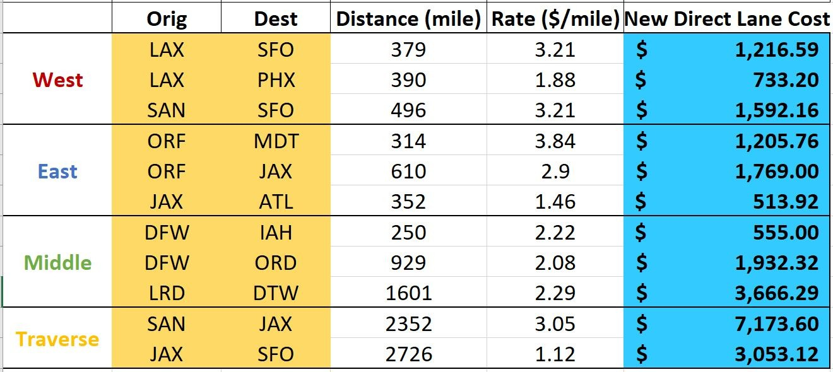
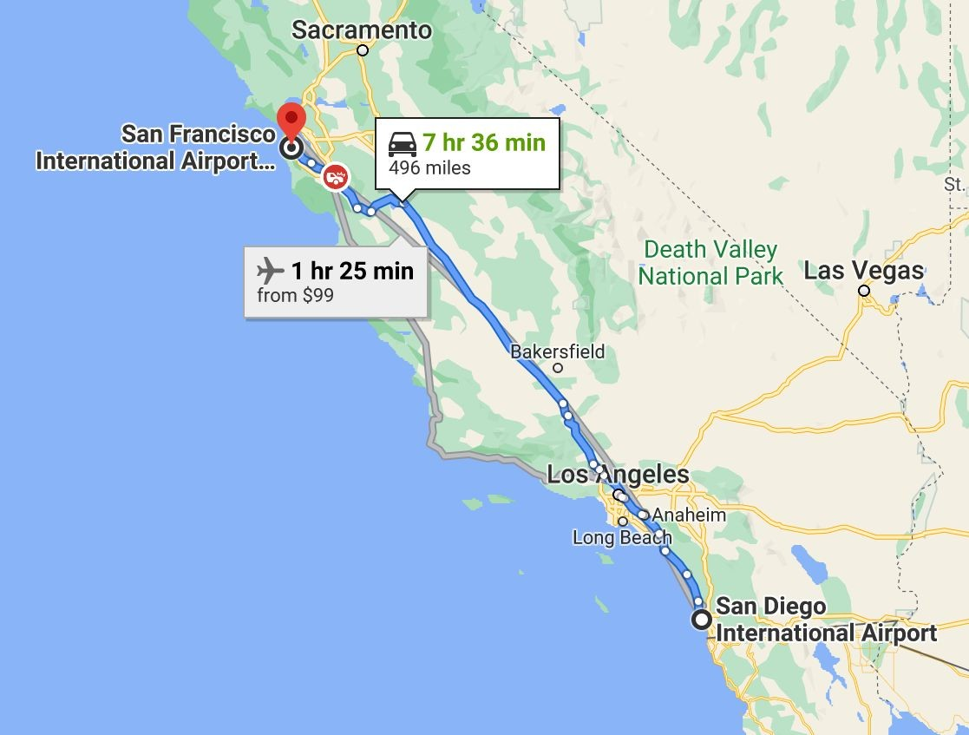
Construct New Direct Lanes
Searching Google maps to get the distance between two airports.
New Direct Line Costs are calculated as distance multiply by the spot rate.

Slide 14
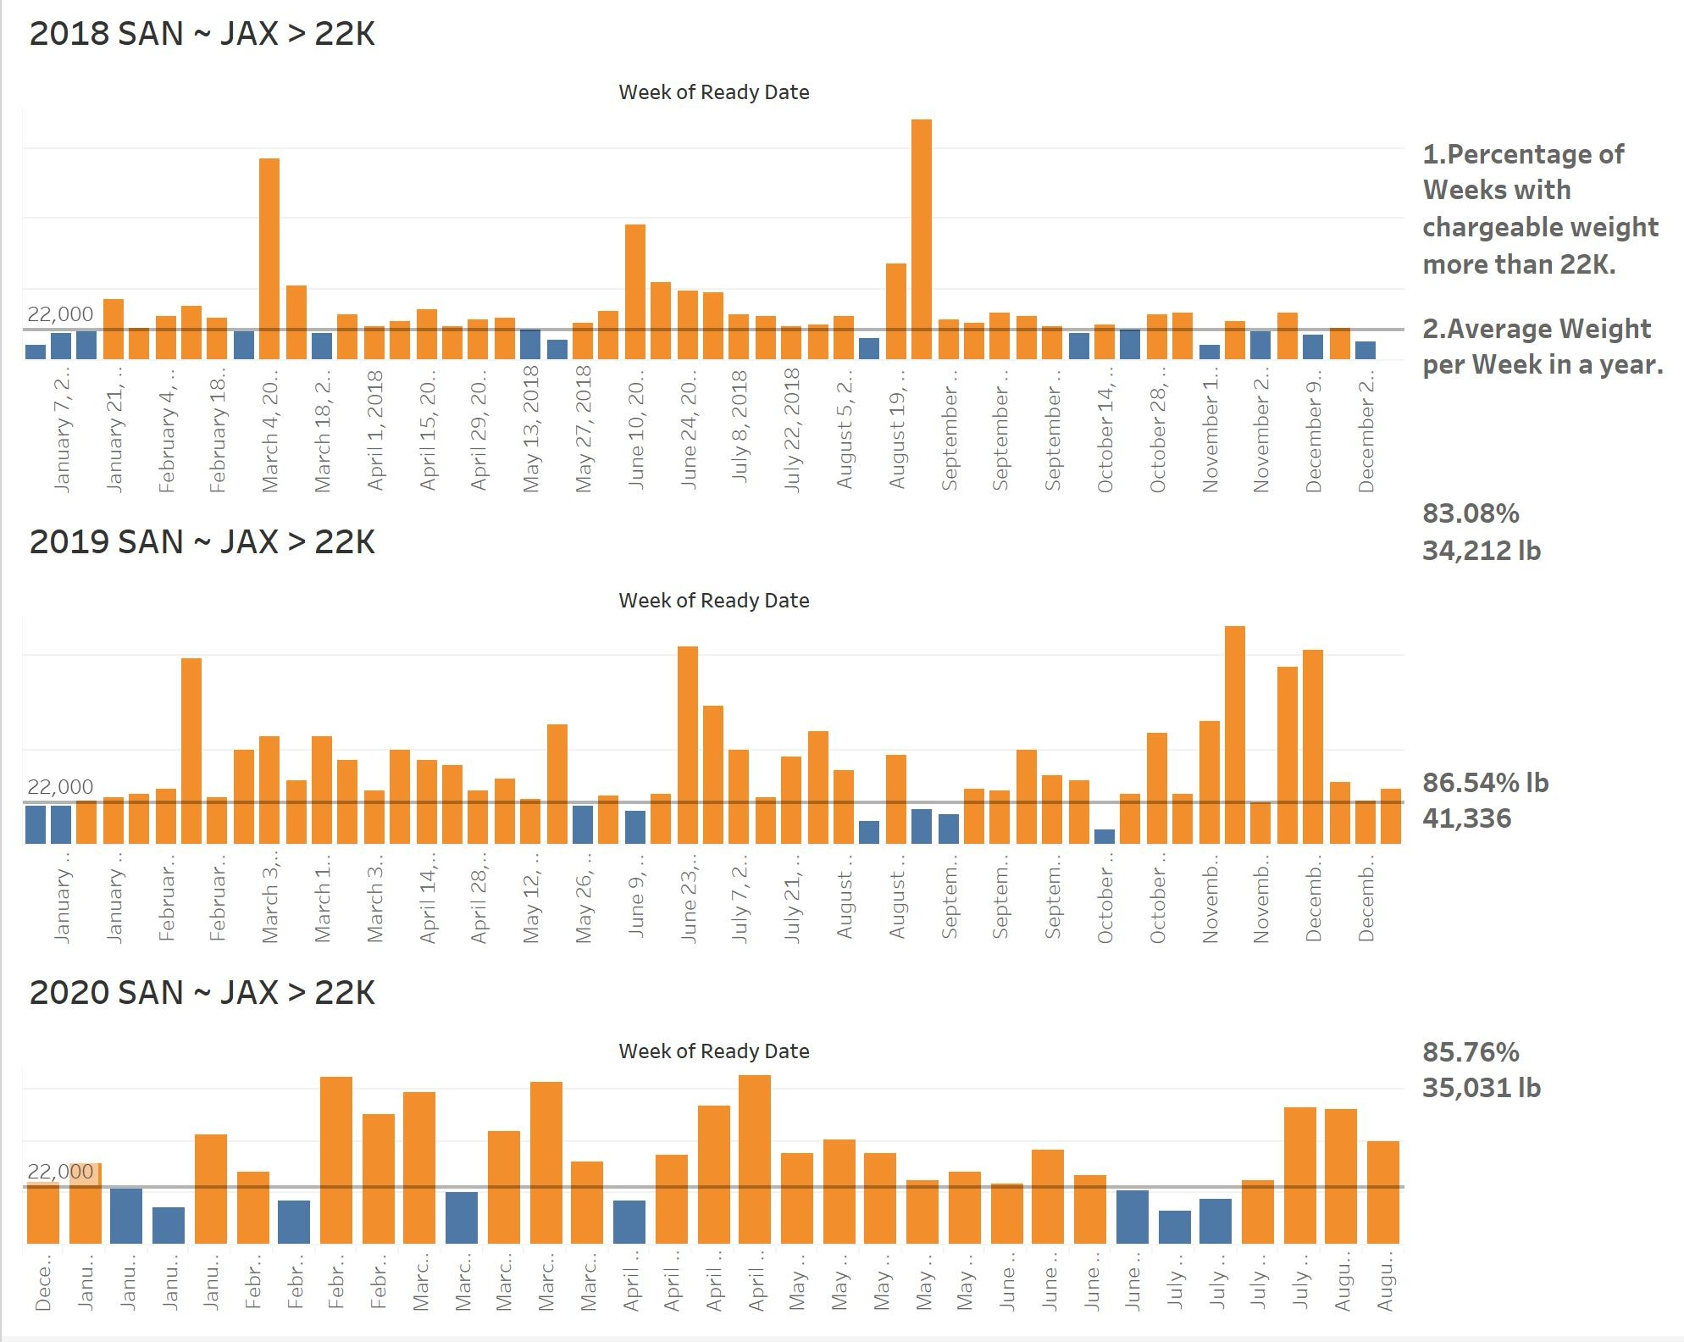
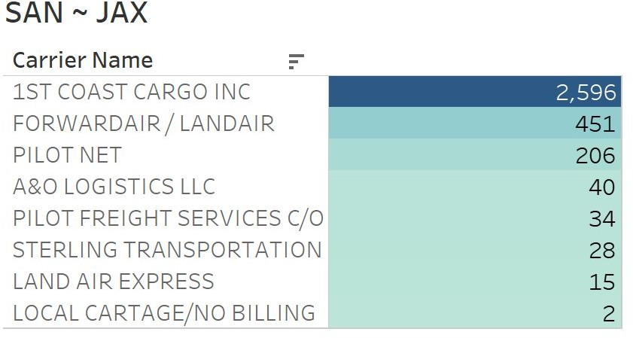
Schedule Analysis
Checking whether the percentage of weeks that have more than 22k chargeable weights is greater than 80%
Figuring out the main Carrier of the route.

Slide 15

Test and Cost Analysis
How should we assign orders to Direct Lane trucks in the most efficient way?
1. Select
2. Sort
3. Run Algorithm
4. Compute
Select Origin & Dest
airports
Select weekdays to collect orders
Select appropriate
service level
Sort by Ready Date
Sort by descending order of Chargeable Weight
Run algorithm to determine which order goes on Direct Lanes trucks
Compute Direct Lanes’ trucks
Compute percentage of time we have enough load to run a truck
* To view python code, please refer to Appendix I

Slide 16
Test and Cost Analysis - Run Algorithm
For every week in a year...
For every selected day for that week... For every order on that day...
True
If adding an order to the truck, the total truck load exceed 30k lbs ?
False
Assign order to its original carrier
Assign order to Direct Lane trucks and add order chargeable weight to truck’s total load

Slide 17
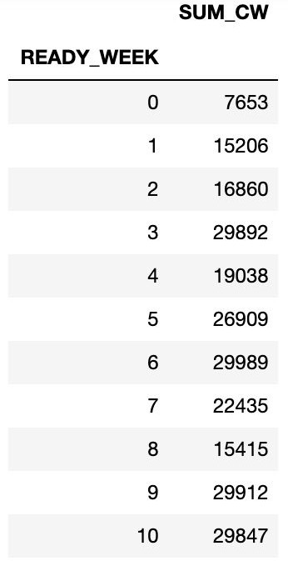
Test and Cost Analysis - Compute Key Metrics
Weekly Direct Lanes Truckload
Percentage of time we have enough CW (benchmark 22k lbs)
Capacity gained in the Net by pulling some loads out of the overall network
Cost saved by running Direct Lanes
Weekly Direct Lanes Truckload

Slide 18
1
2
3
4
5
Business Objective
Route Selection
Data
Model
Recommendation

Slide 19
Filtering Routes by Weights Requirement
Area | Org | Dest | Year | % of Weeks over 22k CW
East | ORF | MDT | 2020 | 91%
 |  |  | 2019 | 91%
 |  |  | 2018 | 91%
Routes that have more than 22k weekly total chargeable weights over 80% weeks from 2018 to 2020:
ORF - MDT, JAX - ATL, LAX - PHX, SAN - SFO, LAX - SFO, SAN - JAX, JAX - SFO

Slide 20
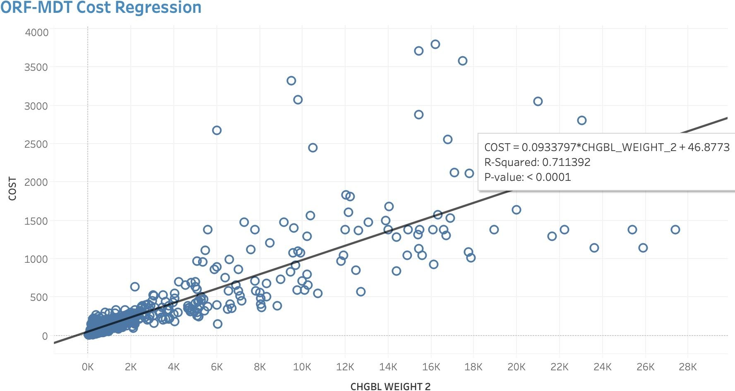
Estimation for Third-party’s Cost
Because parts of the cost rate for some third-party (i.e. 1st Coast Cargo Express) is 0 or 0.01 in the dataset, we estimated those costs by linear regression models for later calculations of cost-savings.
The cost-savings routes are: ORF-MDT, JAX-ATL, LAX-PHX, SAN-SFO, LAX-SFO

Slide 21
Overview for Filtering Process
DFW - IAH DFW - ORD LRD - DTW ORF - JAX ONT - LAX
Initial routes
SAN - JAX JAX - SFO
Routes that meet the
weights requirement
ORF - MDT JAX - ATL LAX - PHX SAN - SFO LAX - SFO
Routes that save costs

Slide 22
1
2
3
4
5
Business Objective
Route Selection
Data
Model
Recommendation

Slide 23
Shipping Schedule Recommendation
Area | Org | Dest | Transit Hours | Collect Date | Shipment Date | Average Capacity Savings (per year) | Average Cost Savings ($/year)
East | ORF | MDT | 4.49 | Mon - Fri | Sat | 6995 | 116790
 | JAX | ATL | 5.03 | Tue - Thur | Fri | / | 179281
West | LAX | PHX | 6.15 | Mon - Fri | Sat | 6206 | 95855
 | LAX | SFO | 6.89 | Mon - Fri | Sat | / | 54301
 | SAN | SFO | 9.02 | Mon - Tue | Wed | / | 76381
 |  |  |  | Wed - Fri | Sat | / | 100263

Slide 24
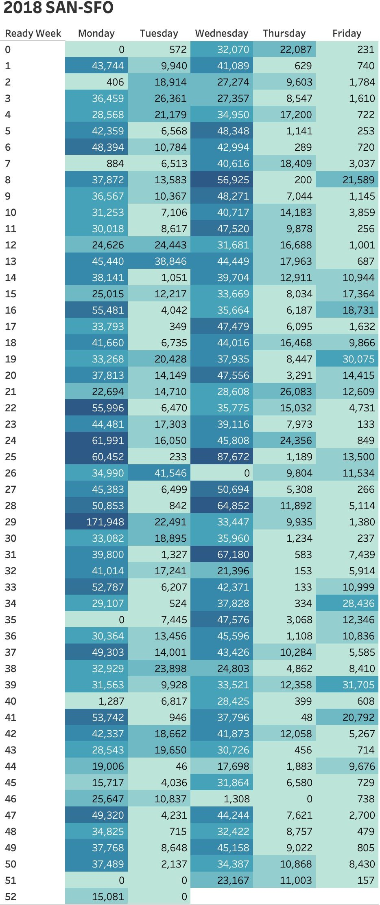
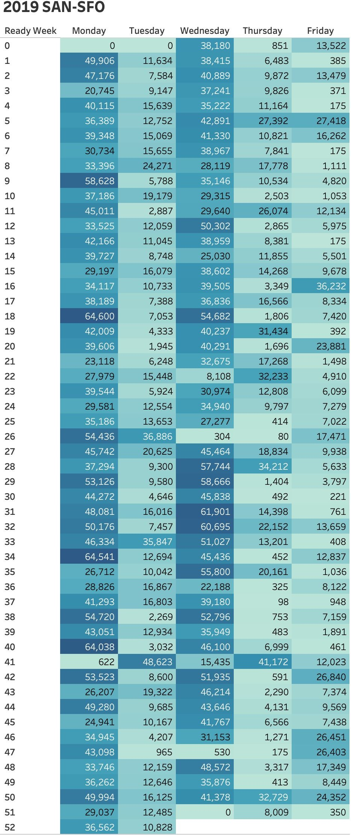
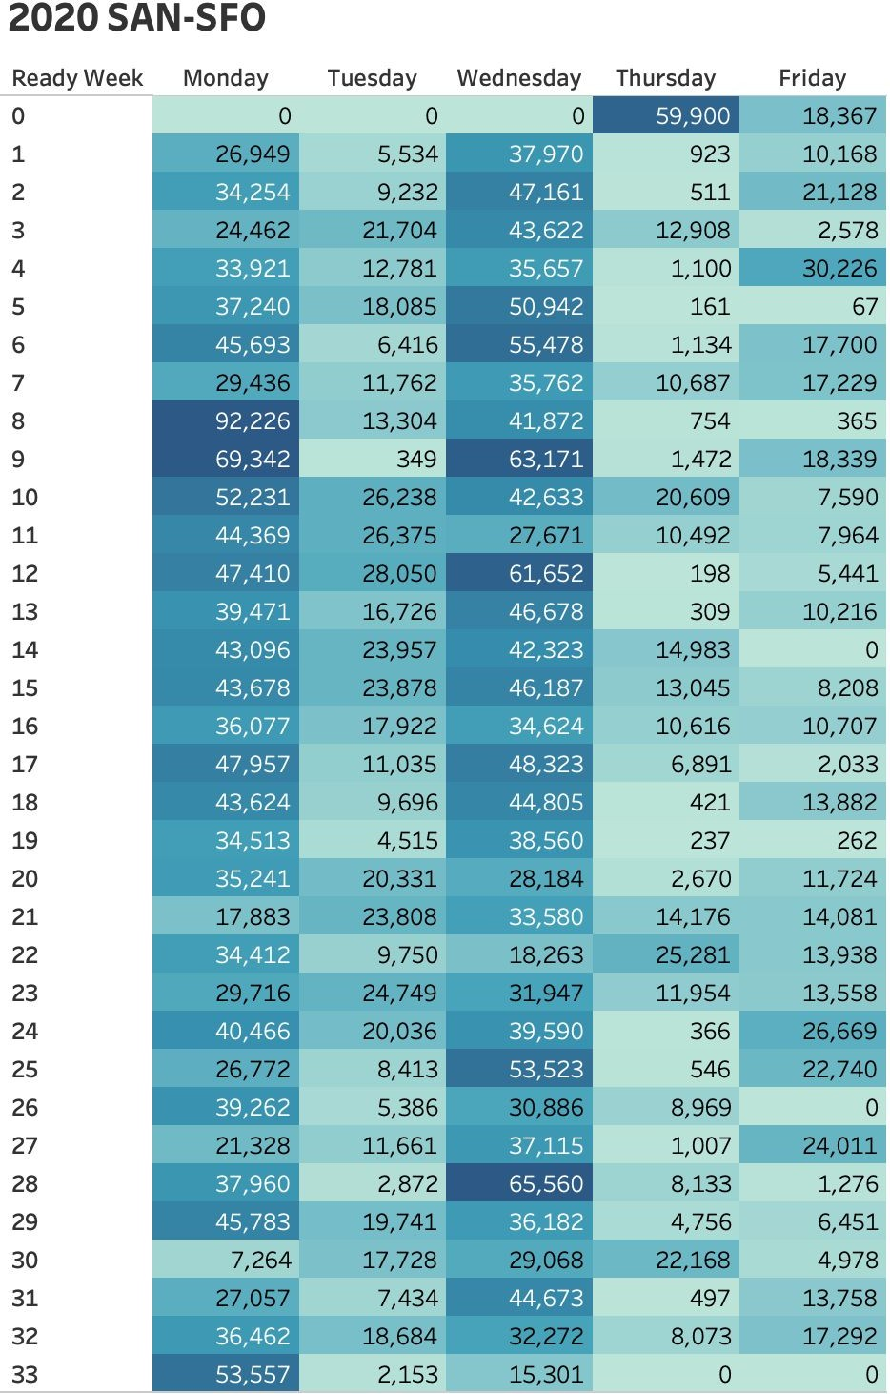
Special Route: SAN-SFO
The Western route
SAN-SFO is overloaded:
Most week from 2018-2020 have the chargeable weight more than 30K on Monday & Wednesday
Recommend to ship twice a week:
Wednesday
Saturday

Slide 25
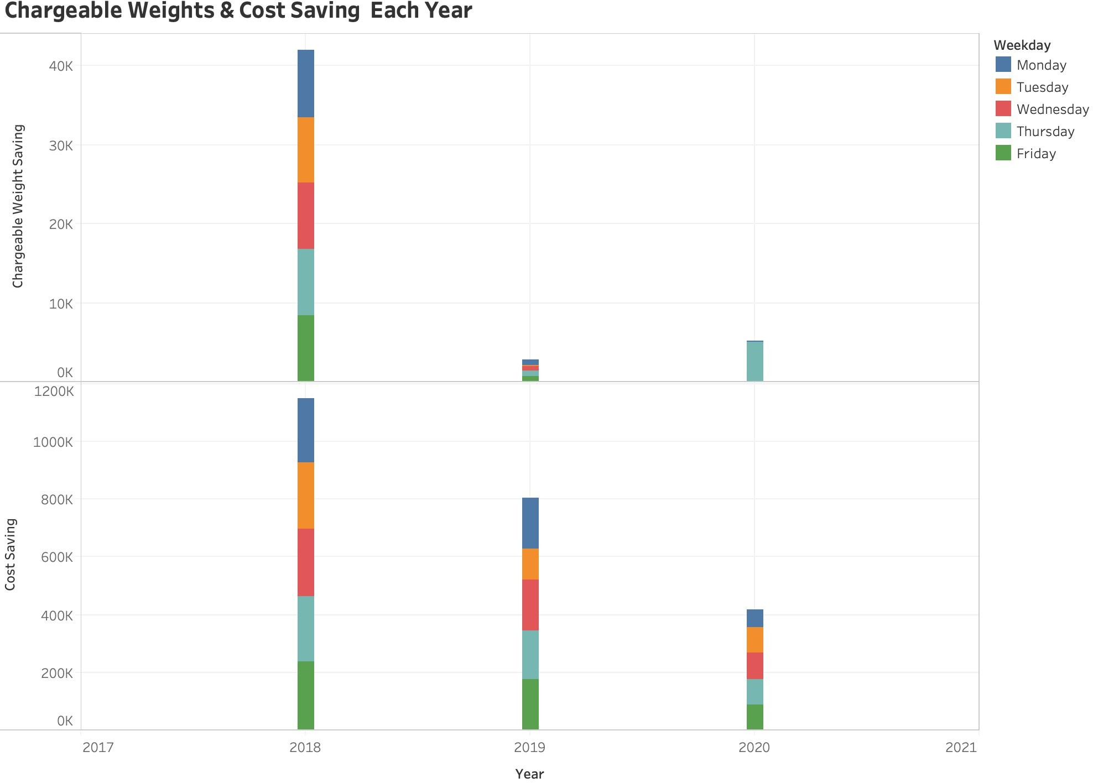
Recommendation for SAN-SFO
If considering the shipment of ‘Third-day’ & ‘Second- day’, they can consider to change the delivery schedule for SAN-SFO: once a day during each weekday
Save more chargeable weight & cost, hence create more profits(See the bar chart on the left to see the total savings).
Reduce the Delivery time for Economic Shipping
Attract more Third-day & Second-day shipping customers
Concerns:
The distance between SAN-SFO is relatively long in the west region
The cost of drivers and trucks might increase

Slide 26
Recommendations for Further Development
Keep an eye on the potential direct lines
ONT-LAX, JAX-ATL, DFW-IAH, DFW-ORD, LRD-DTW
They have high chargeable weights compared to the other routes, but not high enough for a truck to deliver the loads for most of the weeks during the year.
Considering more economical mode of shipping
Some routes are excluded because of high cost of trucking shipment: SAN- JAX, JAX-SFO
If they can change to more efficient & economical shipping methods, there could be more opportunities for direct line development.

Slide 27
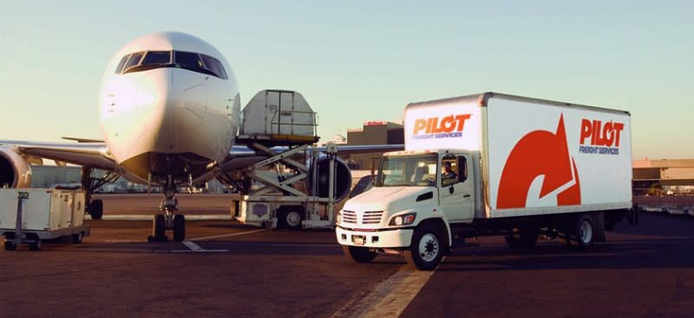



Slide 28
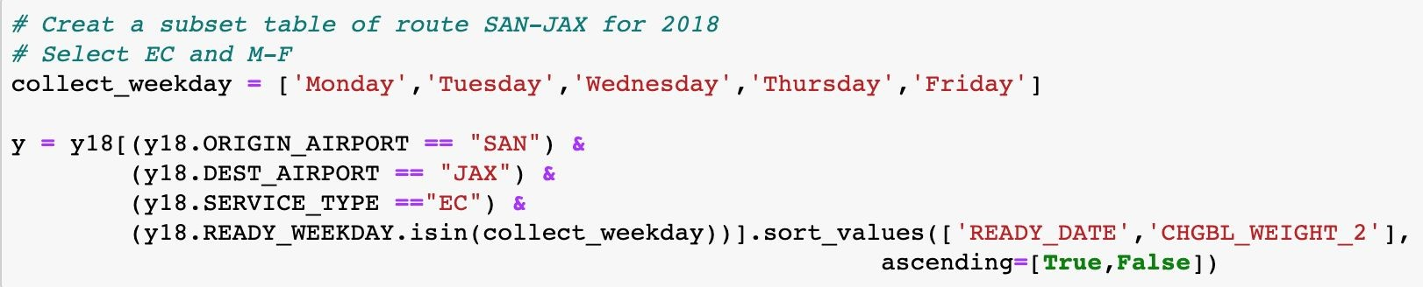
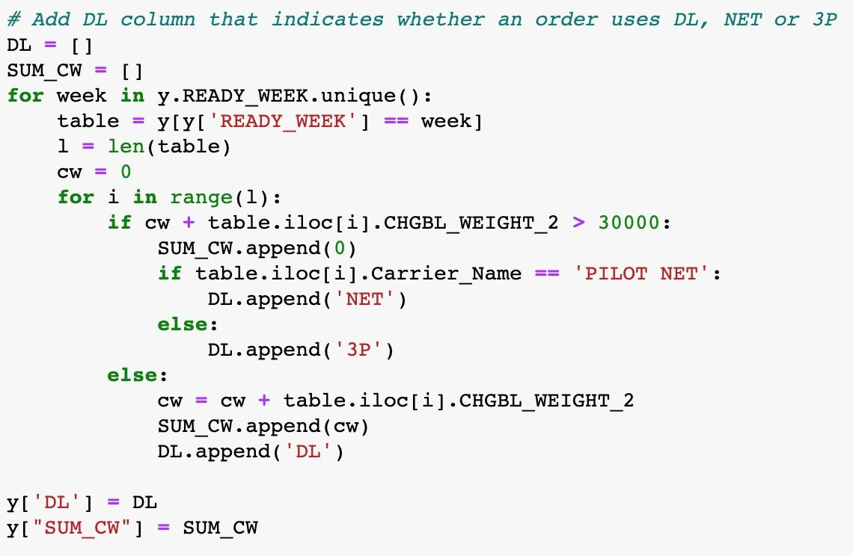
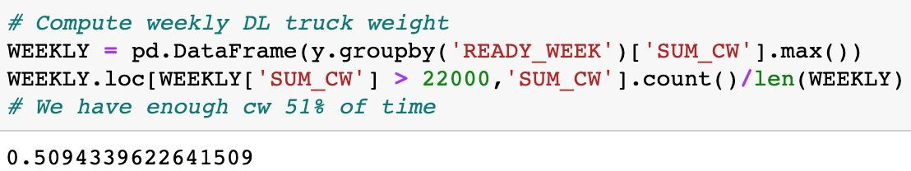
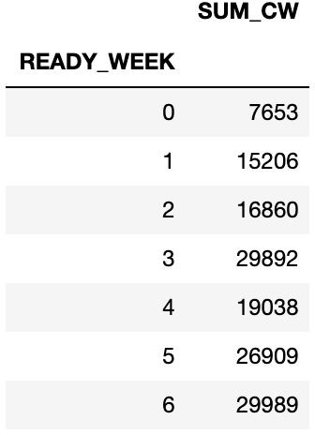
Appendix I - Python Algorithm
Select
Sort
3. Run Algorithm
4. Compute

